Slide 1
PROJECT TITLE: Secure data hiding in image using steganography
CAPSTONE PROJECT
Presented By:
Student Name : L S Veisounii
College Name & Department : Manipur University

Slide 2
OUTLINE
Problem Statement
Technology used
Wow factor
End users
Result
Conclusion
Git-hub Link
Future scope

Slide 3
Problem Statement
Data security has become one most crucial domain, in order to protect sensitive information from cyber threats, with the rapid growing of cyberspace.
Increasing need for secure communication.
Traditional encryption methods are often vulnerable to attacks.
Ensure efficient encoding and decoding processes.
Minimal impact on image quality to avoid detection.
Sufficient data capacity.
Protect against steganalysis attacks.

Slide 4
SYSTEM REQUIRMENT
Hardware Requirements
Processor: Intel Core i3 & above
RAM: 4GB
Storage: 1GB free Space
Display: 1024x768 (integrated GPU)
Software Requirement:
Operating System: Windows 10/11, Linux , or macOS
Programming Language: Python 3.x or Java
Libraries & Tools: OpenCV, NumPy, PIL
Encryption Algorithms: AES, RSA
Steganography Tools: OpenStego

Slide 5
Technology used
Image Processing Techniques:
Least Significant Bit (LSB) Substitution
Discrete Cosine Transform (DCT)
Discrete Wavelet Transform (DWT)
Pixel Value Differencing (PVD)
Cryptography for Enhanced Security:
AES (Advanced Encryption Standard)
RSA (Rivest-Shamir-Adleman)
Chaotic Encryption
Machine Learning & AI:
Deep Learning
Neural Networks

Slide 6
Wow factors
Hybrid Steganography Approach: (Combines LSB, DCT, DWT )
Multi-Layer Encryption for Added Security: AES-256, RSA, or Chaotic encryption
High-Capacity Data Hiding: Run-Length Encoding (RLE) & Huffman Coding
Secure and Tamper-Proof Mechanism: watermarking or hashing (SHA-256)
Real-Time Stego-Image Quality Analysis: PSNR (Peak Signal-to-Noise Ratio) and SSIM (Structural Similarity Index)
Multi-Format Support: JPEG, PNG, BMP, GIF

Slide 7
End users
The end users of this project range from government agencies to individual users who require enhanced security and confidentiality in data transmission.
Academics & Research Institutions
Banking & Financial Institutions
Military & Defence Organizations
Digital Forensics & Law Enforcement
Medical & Healthcare Industry
Journalists
Corporate Sector & Businesses

Slide 8
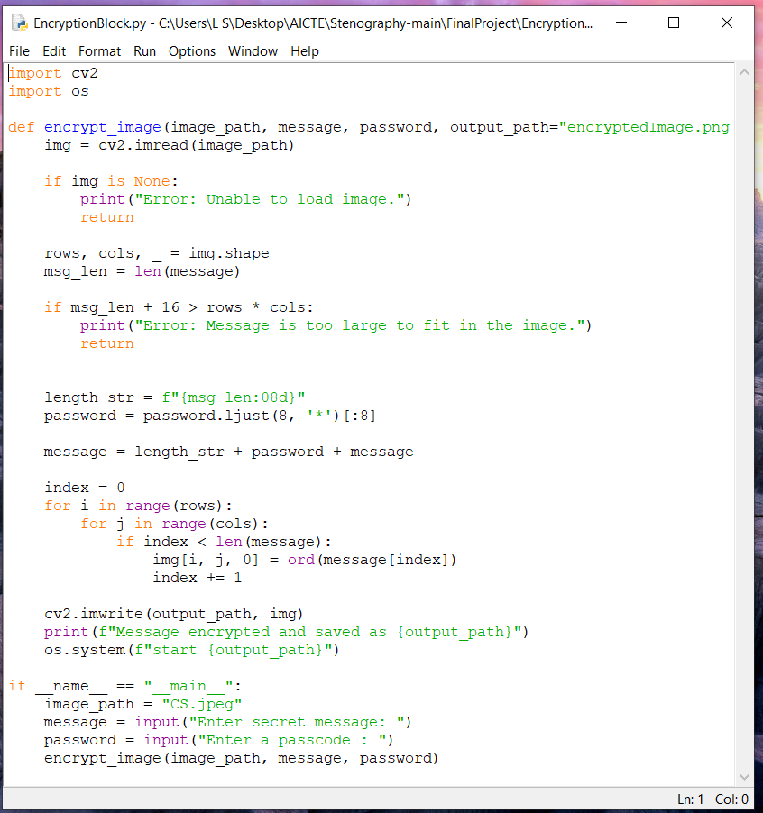
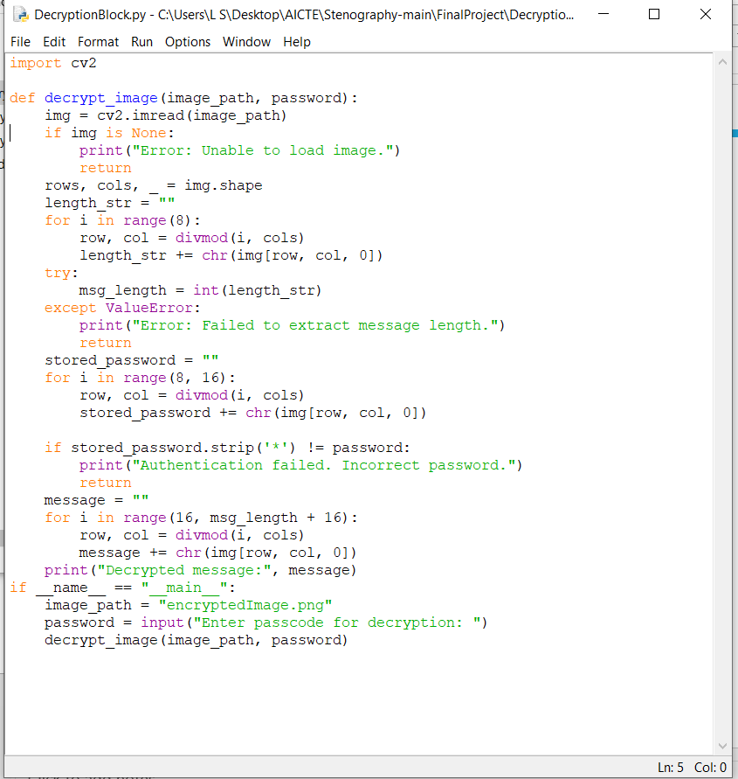
screenshot
Fig: Encryption
Fig: Decryption

Slide 9
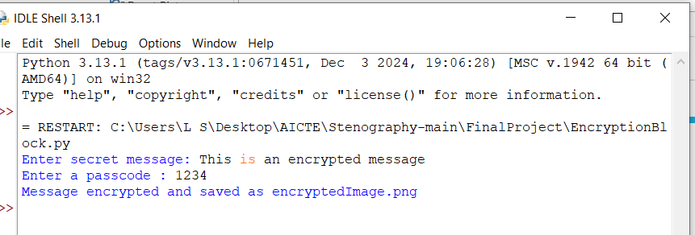
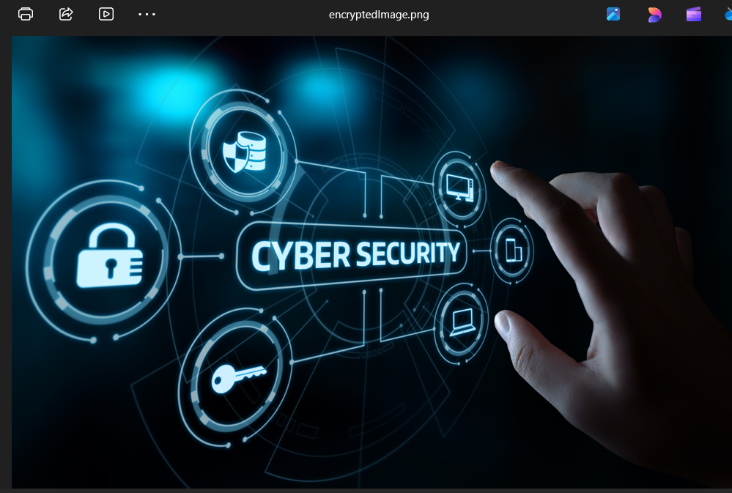
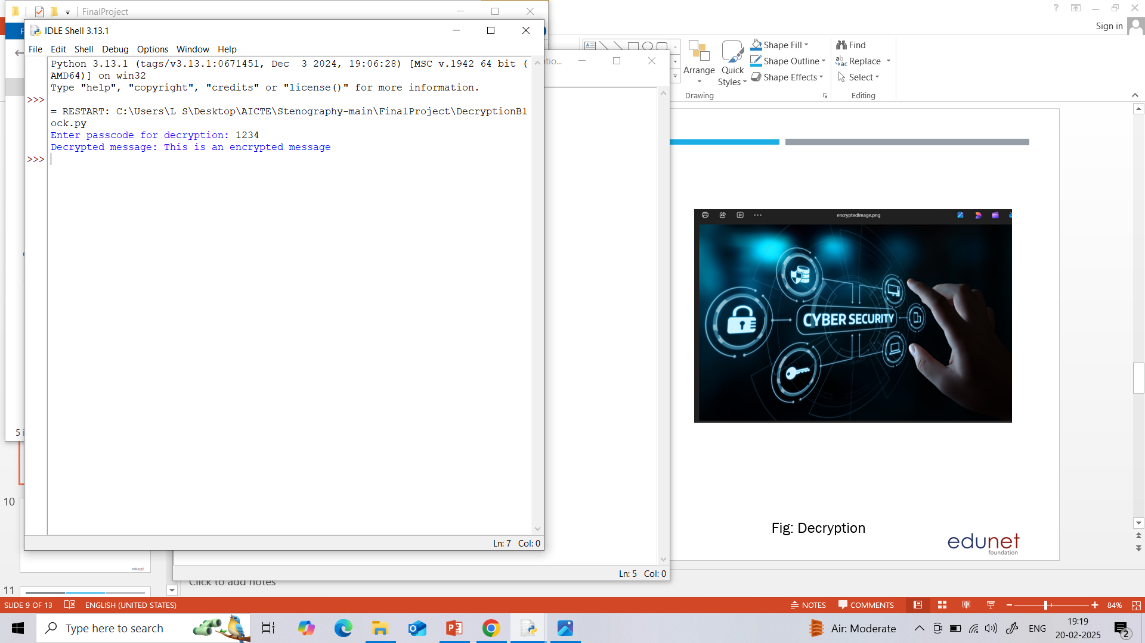
screenshot
Fig: Encrypting shell
Fig: EncryptedImage
Fig: Decrypting Shell

Slide 10
Conclusion
In today's digital world, securing sensitive data from unauthorized access and cyber threats is a growing challenge. Traditional encryption methods are detectable and prone to attacks. Need for a covert, secure data-hiding technique to ensure confidentiality.
Steganography-based Secure Data Hiding in images.
Advanced techniques (LSB, DCT, DWT) for undetectable embedding.
Enhanced security with AES/RSA encryption & compression.
AI-based steganalysis resistance for better stealth.
Key Achievements:
High security & imperceptibility with minimal image distortion.
Efficient & scalable for various applications (Cybersecurity, Banking, Healthcare, etc.).
User-friendly system for easy implementation.
A robust solution for modern data security challenges.

Slide 11
GitHub Link
https://github.com/lsveisounii/AICTE-STEGO.git

Slide 12
Future scope(optional)
The field of steganography and secure data hiding continues to evolve, offering new possibilities for enhancing security and stealth in digital communication. Some potential future advancements and applications:
AI & Machine Learning Integration
Real-Time & Cloud-Based Steganography
Multi-Format Steganography
Mobile & IoT Steganography

Slide 13
THANK YOU

